Slide 1
EXCEL FINAL EXAM
HARISH N J

Slide 2
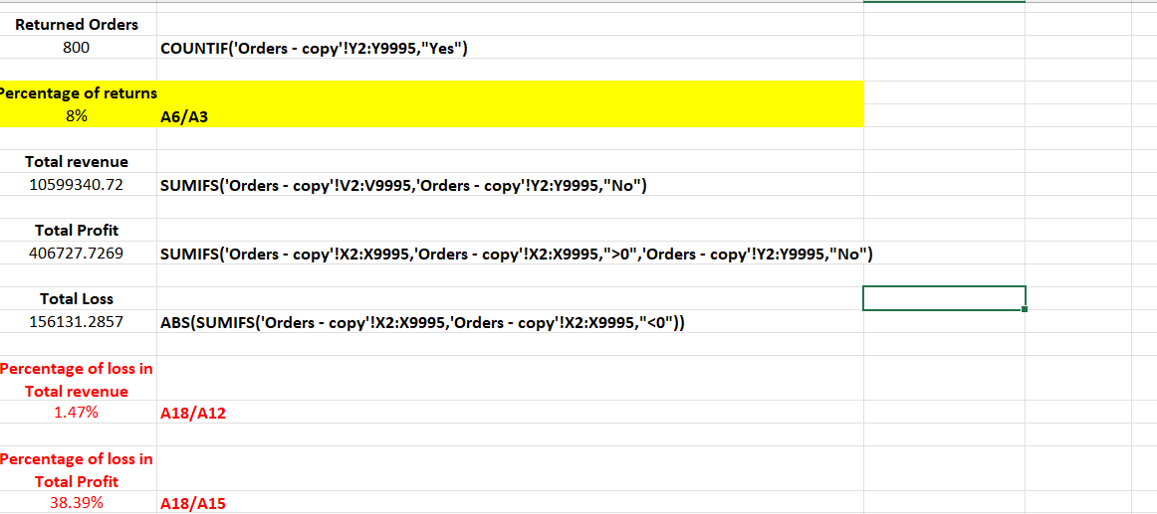
1)
INSIGHTS
Using xlookup,we attach the returns with orders table and we find the total number of orders
returned.percentage is calculated by dividing the count of returned order with total no of orders.
The total loss due to returns in sales revenue and profit was found .
INFERENCE
Percentage of returns is 8%
Percentage of loss in Total revenue is 1.47%
Percentage of loss in Total Profit is 38.39
FORMULA:XLOOKUP(Orders!B2,Returns!B:B,Returns!A:A,"No",0)
SUMIFS('Orders - copy'!V2:V9995,'Orders - copy'!Y2:Y9995,"No")

Slide 3
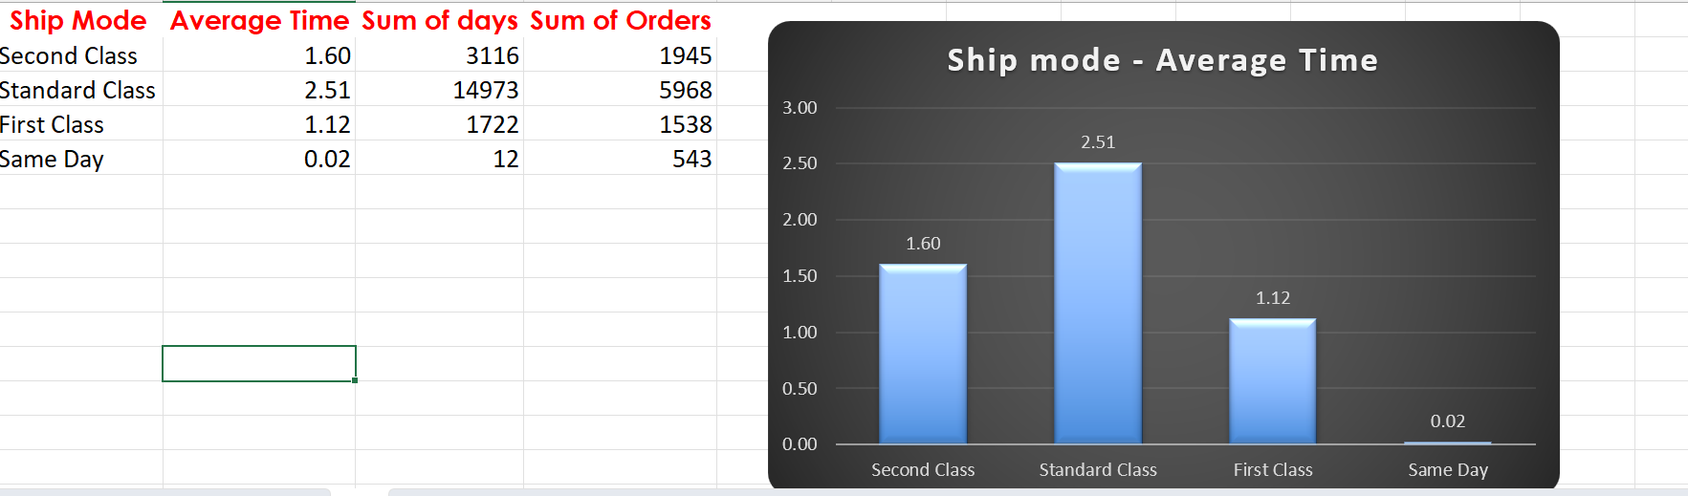
2)
INSIGHTS
Time is calculated by the formula (shipdate-orderdate).Using pivot table,shipping mode is given into rows and time is given to values.
We sort according to get the fastest and slowest delivery times.
INFERENCE
Same day ship mode is fastest
And standard class is slowest
FORMULA:DELIVERY TIME=SHIPDATE-ORDERDATE

Slide 4
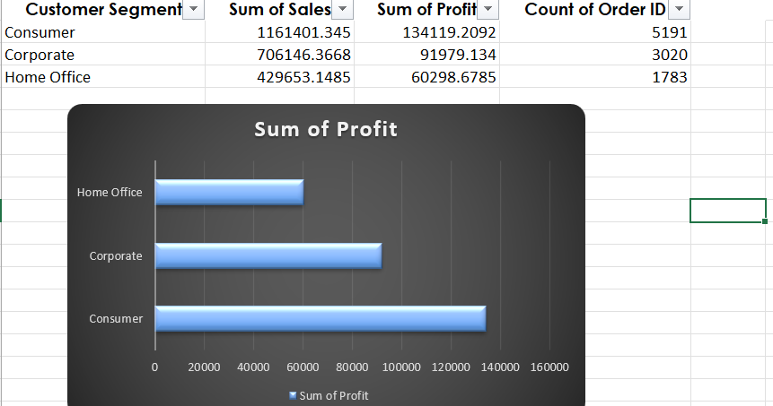
3)
INSIGHTS
Segmenting customers based on factors such as total sales, frequency of orders, average order value, or product preferences helps identify distinct groups with similar buying patterns.
INFERENCE
Consumer segment has highest sum of sales and sum of profit than corporate or home office
FORMULA:using pivot chart

Slide 5
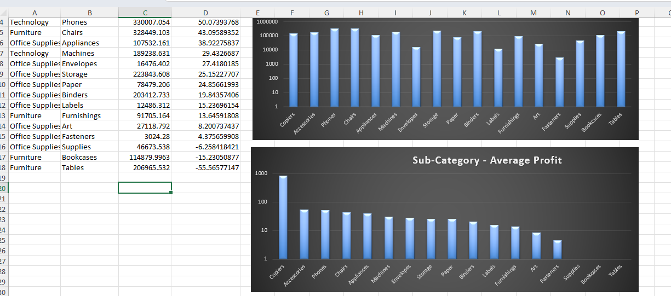
4)
INSIGHTS
The average profit margin provides insights into the profitability of products within each category and sub-category, taking into account variations in cost and pricing strategies.
INFERENCE
TECHNOLOGY AND PHONES has highest sum of sales
FORMULA: using pivot chart

Slide 6
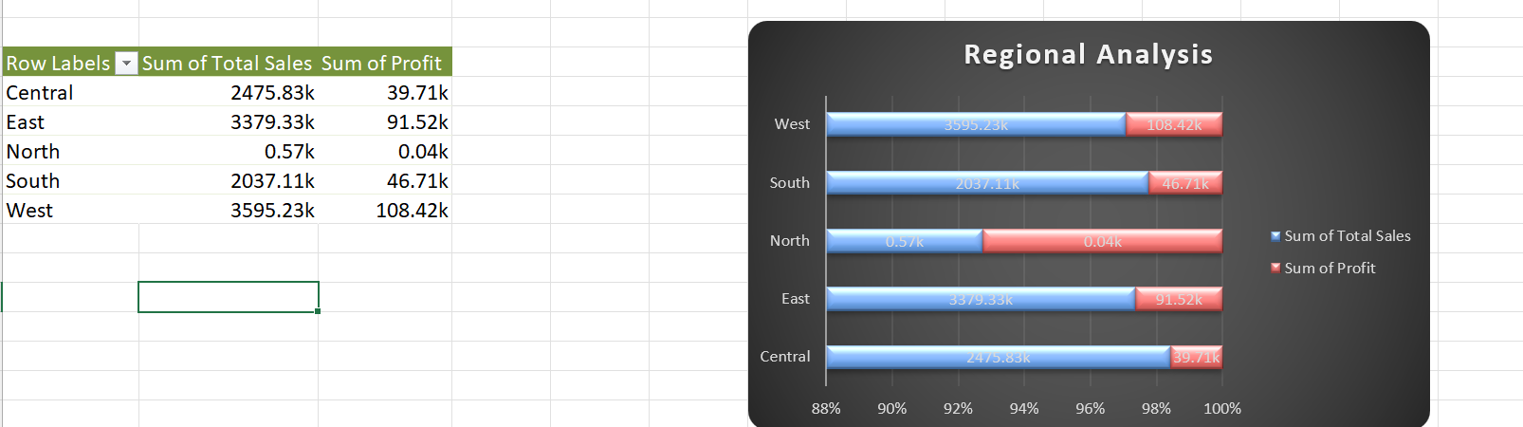
5)
INSIGHTS
Aggregate sales data by region to determine total sales volume for each region.
Compare sales performance across regions to identify regions with the highest and lowest sales. This comparison helps understand geographic variations in demand and market potential.
INFERENCE
West has high sum of sales and sum of profit
FORMULA: using pivot chart

Slide 7
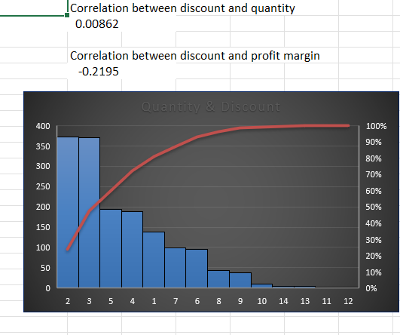
6)
Insights
Calculating the correlation between the discount rate and the quantity sold provides insights into the relationship between discounts and sales volume. A positive correlation suggests that higher discounts are associated with increased sales, while a negative correlation indicates the opposite.
INFERENCE
Correlation between discount and quantity is 0.00862
Correlation between discount and profit margin is -0.2195

Slide 8
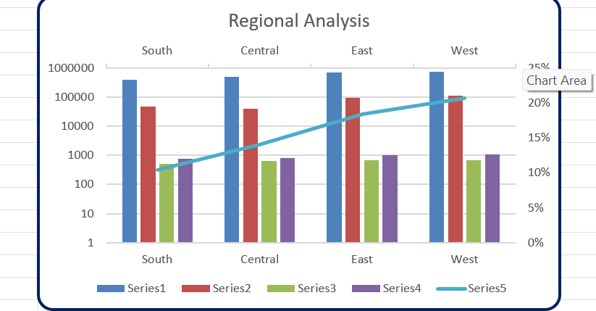
7)
INSIGHTS
Conduct market research to identify regions where your products or services are underrepresented or where there is a growing demand for similar offerings.
Analyze demographic data, economic indicators, consumer behavior, and competitive landscape to assess market potential and identify regions with low market saturation and high growth potential.
INFERENCE
Total customers is high in west and growth rate is also high in west compared to others
Saturation metric is high in west
FORMULA: using pivot chart

Slide 9
8)
unique customers Who have bought repeated puchase | 769
total unique customers | 793
Retention percentage | 96.97%
INSIGHTS
Analyzing repeat orders from existing customers allows businesses to calculate the customer retention rate, which represents the percentage of customers who continue to make purchases over time.
INFERENCE
unique customers Who have bought repeated purchase is 769
total unique customers is 793
Retention percentage is 96.97%
FORMULA: using pivot chart

Slide 10
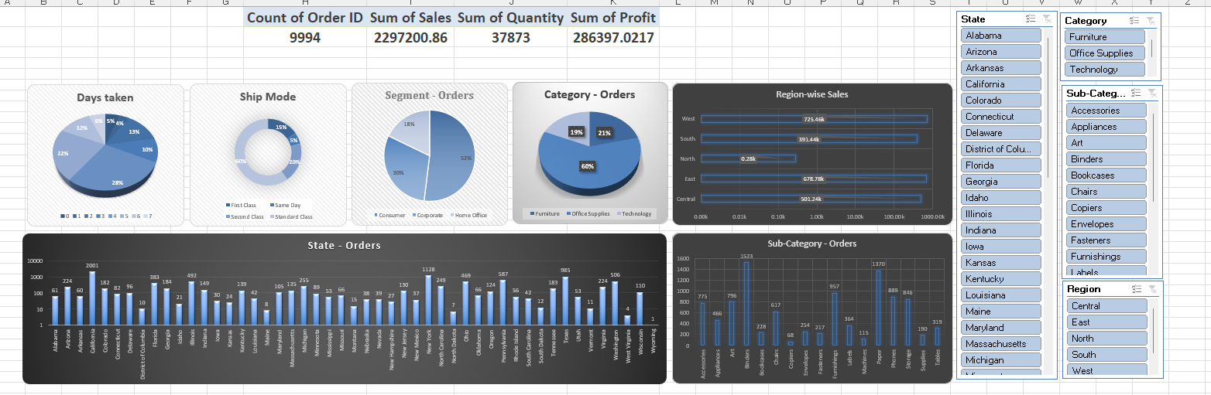
9)DASHBOARD

